Slide 1
Fast Track to F#
Introducing functional Programming

Slide 2
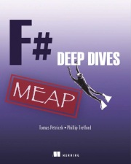
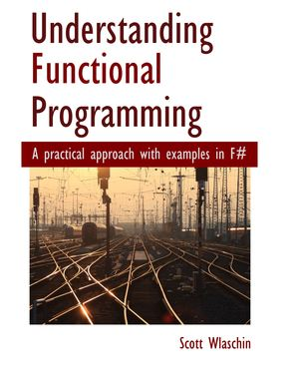
About Us
Tomas Petricek
Author of F# book for C# programmers
Worked with the F# team at Microsoft
First blogged about F# in May 2006
Scott Wlaschin
20 years experience in dev, design and architecture of business software
Author of F# for Fun and Profit

Slide 3
About You
Introductions
What languages have you used?
What are you working on?
What do you want to learn?
What do you do outside work ☺?

Slide 4
Functional programming
Functional Languages
Modern functional languages F#, Clojure, Erlang
Popular in the industry in recent years
LINQ (2006)
Functional collection-processing
Declarative rather than imperative
C++11 (2011)
Immutability, type inference
Lambda expressions
Java 8 (2014)
Lambda functions
List functions

Slide 5
Why functional style?
Imperative
Declarative
let res = ResizeArray<_>()
let mutable prev = -1
for i in input do
if prev <> -1 then
res.Add(i - prev)
prev <- i
input
|> Seq.pairwise
|> Seq.map (fun (v0, v1) ->
v1 – v0)
Describes “how”
Implementation details
Hard to change & extend
Describes “what”
Composing primitives
Easy to parallelize

Slide 6
software stacks trainings teaching F# user groups snippets mac and linux cross-platform books and tutorials
F# Software Foundation
F# community open-source MonoDevelop
http://www.fsharp.org
contributions research support consultancy mailing list

Slide 7
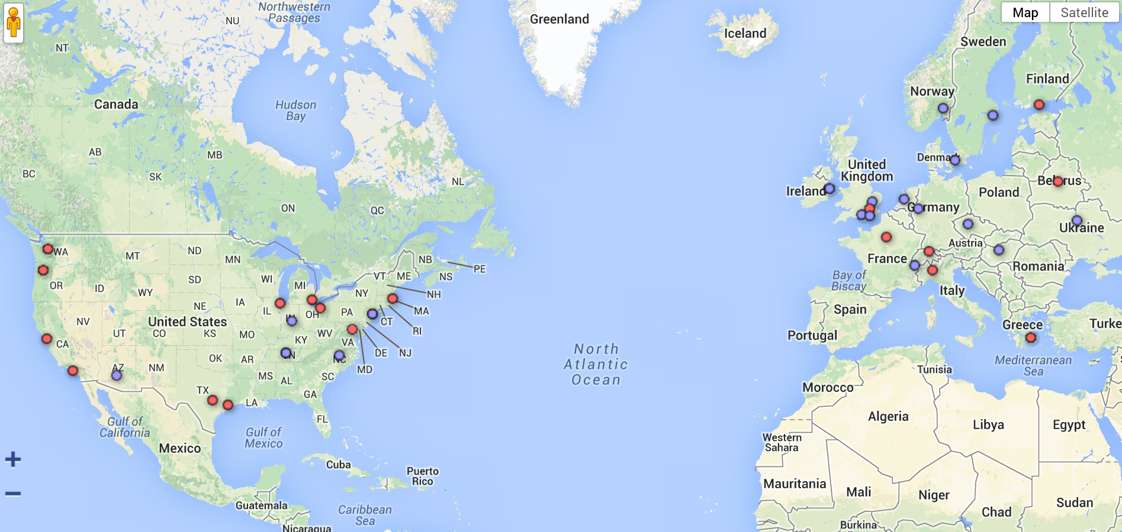
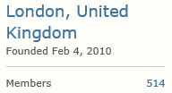

F# Community

Slide 8
F# targets multiple platforms
F#
Mono
GPU
Cloud
JS + Web
.NET
Mobile
Notes:
Desktop
Browser
GPU
Cloud

Slide 9
F# combines multiple styles
F#
Simple (Python)
Robust (.NET)
Object-oriented (C#)
Functional (ML)
Notes:
http://en.wikipedia.org/wiki/Comparison_of_programming_languages
Definitions of FP, OO and Dynamic

Slide 10
Business reasons for F#

Slide 11
Business reasons
Time to Market
Easy prototyping
Efficiency
Easy parallelism
Complexity
Flexible language
Correctness
Advanced types
Runs as .NET code
JIT compilation
Type inference
Closer to math

Slide 12
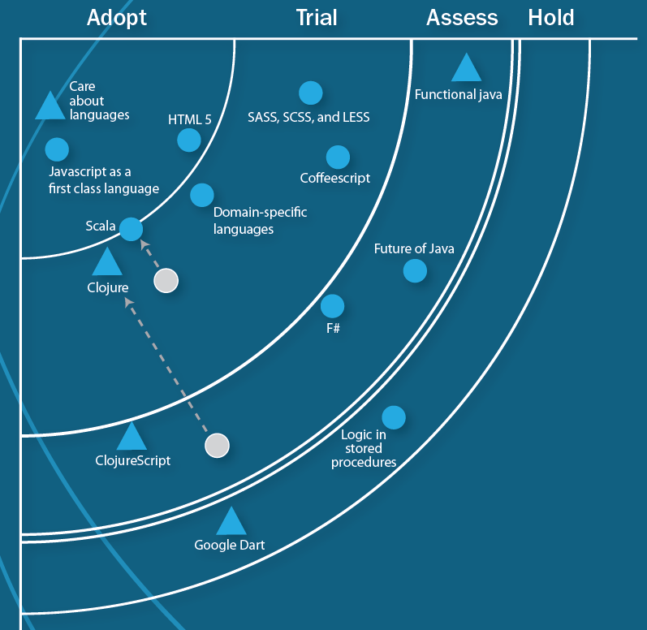
Technology radar
F# is excellent at concisely expressing business and domain logic. Developers trying to achieve explicit business logic within an application may opt to express their domain in F# with the majority of plumbing code in C#.
(ThoughtWorks Technology Radar, March 2012)

Slide 13
Who uses F#?
Time to Market
Kaggle
Interactivity
Machine learning
GameSys
Data processing
Social Gaming
Concurrency
Tachyus
Analysis & reports
Time to market
Credit Suisse
Complexity
Domain-specific
Oil & gas startup
Financial models

Slide 14
What they say
Building valuation models requires rapid development of mathematical models. F# provides a unique combination of features that make it very well suited to this kind of work.
More at: http://fsharp.org/testimonials
One of the world’s largest insurance companies have migrated number crunching and business logic to F# and are happy with the results (10x faster and 10x less code)
Our use of F# clearly demonstrates a sweet spot for the language within enterprise – namely, algorithmically complex analysis of large data sets.

Slide 15
F# application areas
Working with data
F# 3.0 type providers
Modeling domain logic
Functional types and pattern matching
Domain-specific languages
Concurrent programming
Asynchronous workflows
Actor-style concurrency

